Slide 1
THEORIES AND PRACTICES OF SUSTAINABLE DEVELOPMENT
DRIVERS CENTER
Group Work: Flávia Lima | Francesco Ferrario | Gideon Ofori | Luiz Rielli | Vanessa Tavira
PHD IN CLIMATE CHANGE AND SUSTAINABLE DEVELOPMENT POLICIES

Slide 2
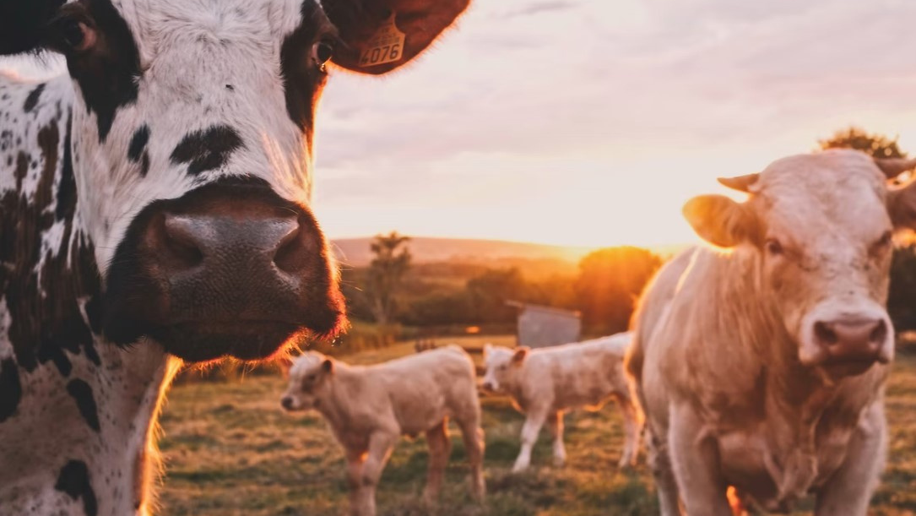
Our Region - Center Portugal
“In the interior of the country, there are mountains and villages of granite and schist. By the sea, fishing villages and cosmopolitan beaches with water sports set the pace of the day. And everywhere centuries old heritage proudly displays the history of the region.”
(Visit Portugal, 2022)

Slide 3
OBJECTIVES OF THE STUDY
Identify the production options available to farmers in Center Portugal by identifying the farming systems practiced on farms in that area.
Characterize the farming systems in terms of:
Productive Intensity; Labour capacity and Productivity; Level of Specialization Production; Pattern of Productive Specialization; Livestock Density & Composition; Use of Agricultural Surface; Fraction of the Territory Occupied by Agriculture.
Interpret the technology reflected in these farming systems, positioning them in relation to the equation:
Labour Productivity = (land productivity) x (area per unit of work);
Analyse the effect of several variables (exogenous to the choice of a farming system), biophysical or socio-economic, which condition/direct the farmer's choice among the different possible farming systems.

Slide 4
OUR METHOD & TECHNIQUES
DRIVERS - CENTER
Quantitative analysis - endogenous variables
In order to create homogenous clusters, we analysed endogenous variables basing the model on the Euclidean squared distance and the ward method. This allows to minimise the distance from the observation at the center of the cluster. The variables were made comparable via the Z-scores standardisation method.
Qualitative analysis - endogenous variables
Once the results from the numerical review were ready we discussed the behaviour of different endogenous variables in order to qualitatively describe the type of farming systems dominant for each cluster.
Finally, with the aid of QGIS, we mapped the clusters in order to have a spatial level of analysis.
Analysis of the exogenous variables
Once the analysis on the endogenous variables was completed, we shifted the focus onto exogenous variables and drives. Mostly to set the work for next stage.
We confirmed these analysis with the use of ANOVA tables, Eta-squared table and confidence intervals.
Notes:
In order to create homogenous clusters, we analysed endogenous variables of parishes basing the analysis on the Euclidean squared distance, this solution allows to calculated the distance between variables between two parishes in a cloud of parishes and the ward method.
In order to make the variables comparable we standardised, via Z-scores standardisation method – to each variable we subtract the average, and we divide by the stnd deviation – this way we get a distribution of variables with average = 0, and stnd deviation=1

Slide 5
OUR DATA
DRIVERS - CENTER
Dataset: 1320 parishes
Data sources: Agriculture Censos 2009; other land data (e.g. slope, soil) from EPIC, and climate variable from World Climate
Endogenous variables:
Proportional variables (i.e. % of land dedicated to an activity)
Orientação Tecnico Economica – specialisation based on the censos
Exogenous variables:
Socio-economic variables (e.g. labour productivity, access to irrigation)
Territorial variables (e.g. quality of soil, climate)
Notes:
From the dendrogram there was evidence that the solution could be between 2 and 10, based on the stability of the solutions.

Slide 7
DATA & RESULTS
DRIVERS - CENTER
Notes:
anova eta2 (0.261) error bars (e.g. productivity intensity)

Slide 8
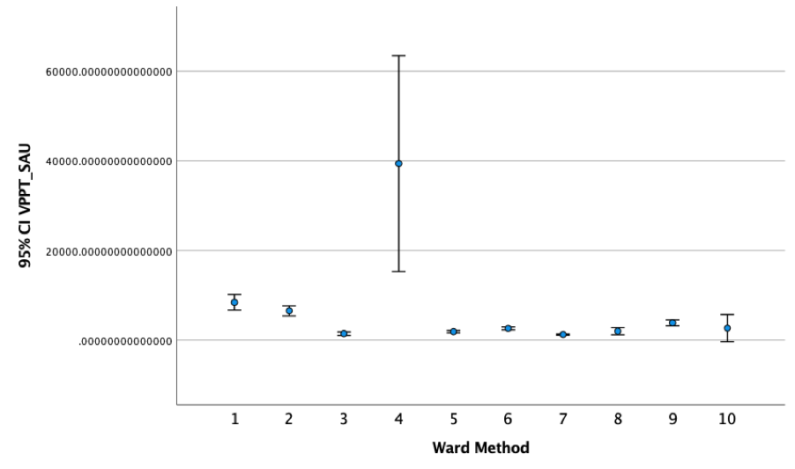
DATA & RESULTS #1
Results validation
Endogenous Variables
Anova analysis
For all variables, we could reject the null hypothesis of equality of the means with significance level of less 0.001%.
Eta squared
Some variables presented excellent variance between clusters while others were quite low.
Confidence intervals
Were done for the variables with low eta squared in order to understand their behaviour.
Notes:
anova eta2 (0.261) error bars (e.g. productivity intensity)

Slide 9
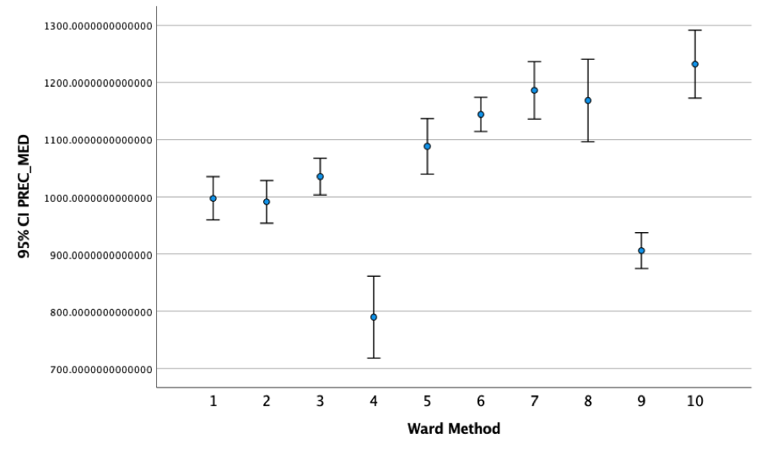
DATA & RESULTS #2
Results validation
Exogenous Variables
Anova analysis
For all variables, we could reject the null hypothesis of equality of the means with significance level of less 0.001%.
Eta squared
Variance between clusters appeared lower than for endogenous variables but this may be related to climatic and morphological variables in a limited geographical space.
Confidence intervals
Explain the behaviour and reinforce the understanding from the low eta squared.
Notes:
anova eta2 (0.119) error bars (e.g. precipitation)

Slide 10
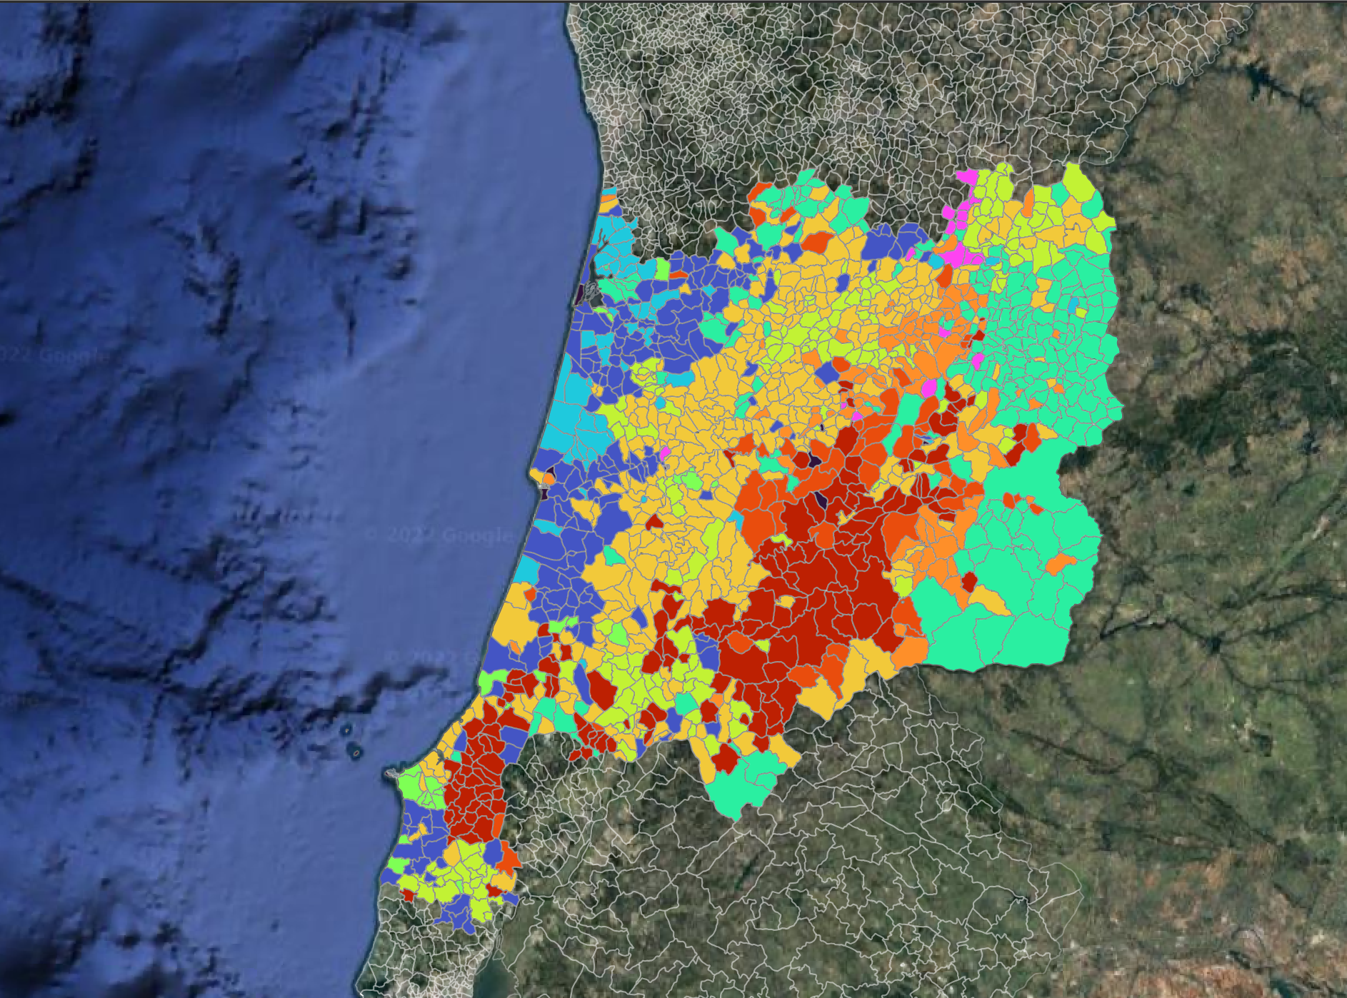
DATA & RESULTS #3
Results validation
Cluster Analysis
Cluster | Description | N
1 | High intensity, high arable land, annual crops, granivores | 190
2 | High intensity, high livestock systems(E_Bovines), milk production | 52
3 | Low intensity, pasture, mixed livestocks(E_Bovine, E_ovinos), low specialisation | 212
4 | High intensity, high arable land, specialised in horticulture | 22
5 | Low intensity, high permanent crops, wine production, equines | 162
6 | Medium-low intensity, permanent mixed crops and mixed livestock | 357
7 | Low intensity, pasture land, ovines specialisation | 94
8 | Low intensity, pasture land, caprine specialisation | 53
9 | Medium-high intensity, permanent fruit crops and equines | 161
10 | Medium-low intensity, chestnuts specialisation | 17
Notes:
anova eta2 (0.261) error bars (e.g. productivity intensity)

Slide 12
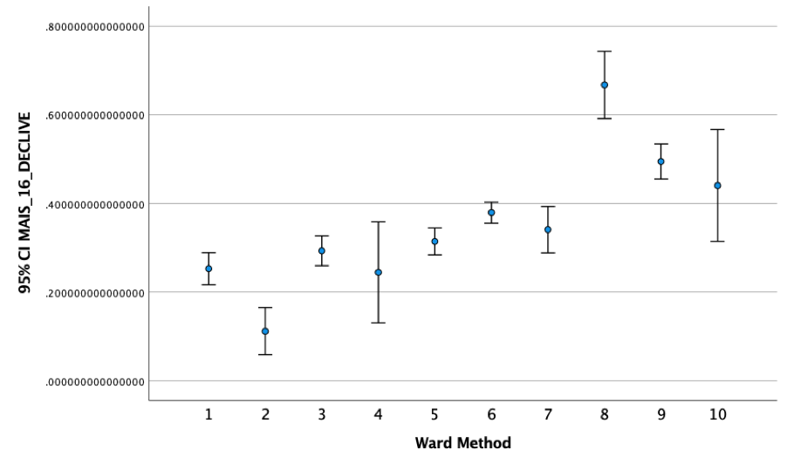
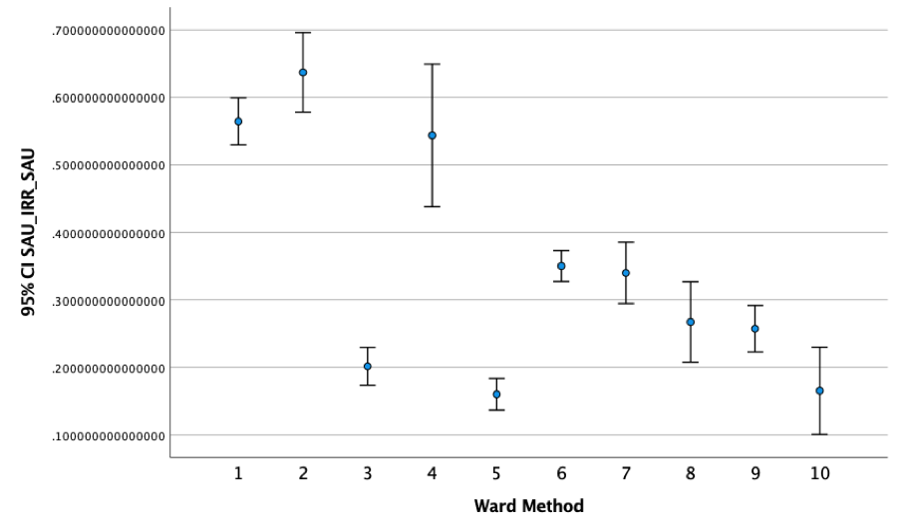
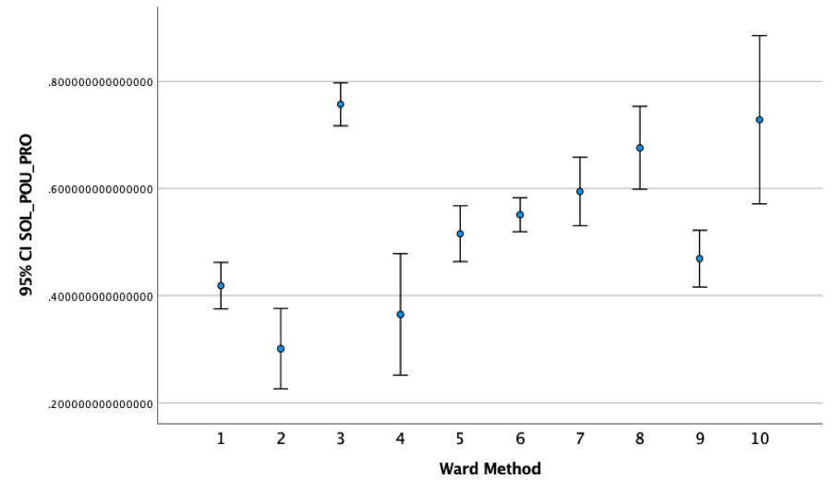
DATA & RESULTS #4
Results validation
Driver Analysis
Based on the ANOVA and squared ETA analysis most of the drivers appear not to be big enough to have a causal relationship with the cluster decision.
Nevertheless, when looking at some of the error bars some more information can be brought to evidence.
Notes:
Nevertheless, when looking at some of the error bars some more information can be brought to evidence:
Irrigation appears important for clusters with high-intensity;
Low-intensity and low soil productivity appear to be linked regarding cluster 3, 8 and 10
In turn, cluster 8 presents steep soils and a goat specialisation
Finally cluster 10, appears to be in the rainiest area which seems to respond well to the needs of chestnut trees - but difference are not so relevant to prove causality

Slide 13
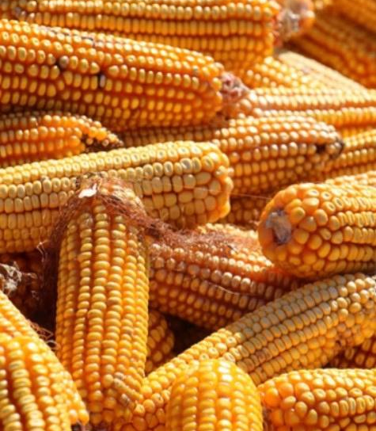
MAIN CONCLUSIONS
The analysis of the endogenous variables allowed us to characterise the farming systems and highlight those variables that define each cluster;
When looking into the exogenous variables there was not a striking evidence of causality. The exogenous variables are statistically significant but the squared-etas are not high enough to prove causality between the clusters and the external drivers. Further analysis in the next steps will look into this.

Slide 14
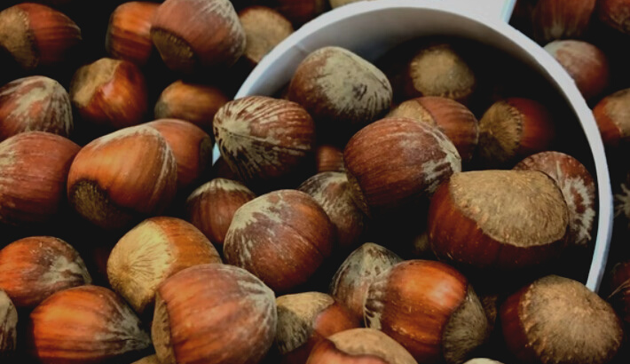
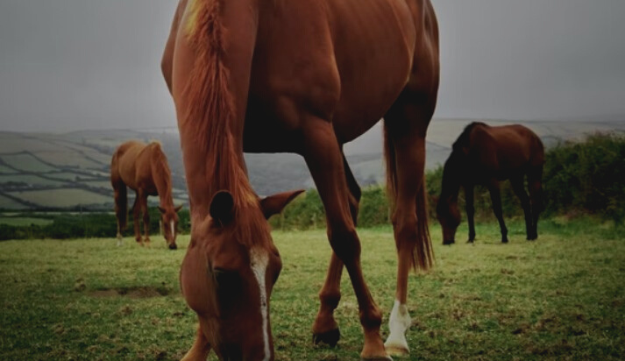
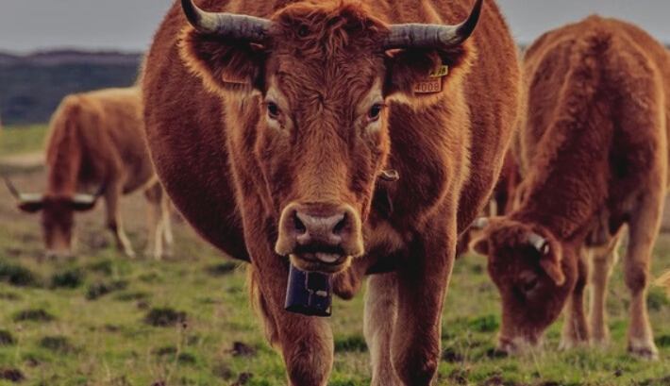
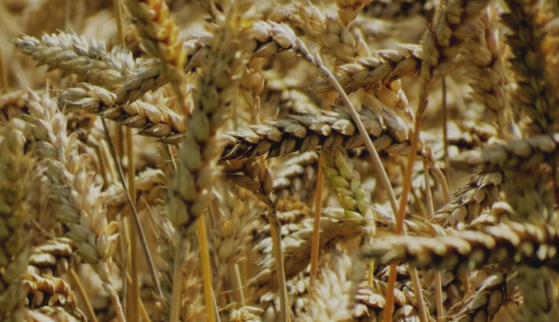
What is the cause behind the concentration and dispersion of some clusters (e.g. cluster 5 and 9)?
What is more relevant? Is it socio-economic drivers or natural drivers?
Discussion
What is the connection between location and clusters?

Slide 15
"A SUSTAINABLE AGRICULTURE DOES NOT DEPLETE SOILS OR PEOPLE." Wendell Berry*
THANK YOU!
*Poet, novelist, and environmentalist Wendell Berry lives in Port Royal, Kentucky near his birthplace, where he has maintained a farm for over 40 years.

